Slide 1
Encapsulation
Lecturer: Ngo Huy Bien
Software Engineering Department
Faculty of Information Technology
VNUHCM - University of Science
Ho Chi Minh City, Vietnam
nhbien@fit.hcmus.edu.vn

Slide 2

Objectives
To present what is encapsulation.
To achieve encapsulation using methods, properties and classes.
To differentiate among public, private, protected, internal, protected internal modifier.
To present why encapsulation is important.

Slide 3

References
Grady Booch et al. Object Oriented Analysis and Design with Application. 3rd Edition. 2007.
Jim Keogh and Mario Giannini. OOP Demystified: A Self-Teaching Guide. 2005.
Meilir Page-Jones. Fundamentals of Object-Oriented Design in UML. 1999.

Slide 4

Encapsulation [1]
Encapsulation is the process of compartmentalizing the elements of an abstraction that constitute its structure and behavior; encapsulation serves to separate the contractual interface of an abstraction and its implementation.

Slide 5
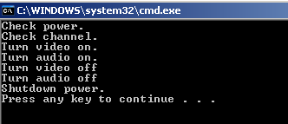
Encapsulation With Method [2]

Slide 6
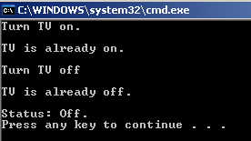
Encapsulation With Property

Slide 7
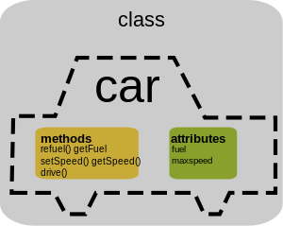
Encapsulation With Class

Slide 8

Namespaces
Namespaces are convenient means of semantically grouping elements.

Slide 9

Nested Namespaces
Avoid name collision

Slide 10

Public Modifier
Signifies that the member is accessible from outside the class’s definition and hierarchy of derived classes.
Program
Vehicle
Name
Run
Mercedes

Slide 11
Private Modifier
Signifies that the member can’t be accessed outside the scope of the defining class.
Program
Vehicle
Name
Run
Mercedes

Slide 12
Protected Modifier
Signifies that the member isn’t visible outside the class and can be accessed by derived classes only.
Program
Vehicle
Name
Run
Mercedes

Slide 13
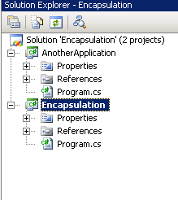
.NET Application Physical Structure
Application
Compilation Unit
Solution
Project
Code File
Code File
Project
Code File
Class
Class
Class
Class
DLL
EXE
Compilation Unit
Assembly
Partially compiled code library for use in deployment, versioning and security.

Slide 14
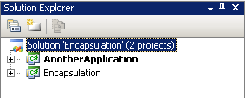
Internal Modifier
Signifies that the member is visible only within the current compilation unit.
Encapsulation
Another Application
Program
Program
Vehicle
Name
Run
Mercedes
Start

Slide 15
Protected Internal Modifier
Signifies that the member is visible only within the current compilation unit and derived classes.
Encapsulation
Another Application
Program
Vehicle
Mercedes
Name
Run
Start

Slide 16
Default Modifier
Internal
Program
Private
Vehicle
Name
Run
Private
Mercedes
Mercedes

Slide 17
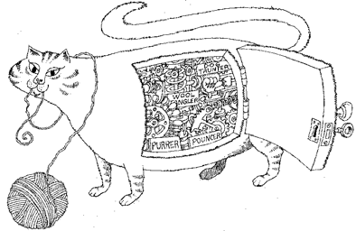
Why Encapsulation? [1, 2]
Encapsulation provides explicit barriers among different abstractions and thus leads to a clear separation of concerns.
Encapsulation hides complexity and prevents implementation access.
Enables objects to be independent and to be packaged into reusable components.
Encapsulation “allows program changes to be reliably made with limited effort”

Slide 18

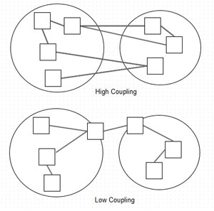
A Solution for Complexity [3]
Encapsulation isolates implementation details from the behavior exposed to clients.
Encapsulation provides loose coupling (connascence, contranascene)
Two components are connascent if a change in one would require the other to be modified in order to maintain the overall correctness of the system.
Connascence is a software quality metric allowing reasoning about the complexity caused by dependency relationships.
But why implementation details isolation and low coupling? – Low complexity and easier for maintainability.

Slide 19

Question
Encapsulation is not just hiding your fields behind accessors. Why?

Slide 20
Information Hiding vs. Encapsulation
Encapsulation means drawing a boundary around something.
The principle of information hiding is the hiding of design decisions in a computer program that are most likely to change, thus protecting other parts of the program from change if the design decision is changed.

Slide 21

Thank You for Your Time

